Slide 1

Predicting Salary An Exploration with Regression
Brendon Happ
Metis 2018

Slide 2
Process
Acquire Data
Feature Selection
Feature Transforms
Regularization
Future Work

Slide 3

Acquiring Data
Glassdoor is not fond of their data being taken
Utilize Scrapy for simultaneous rotating IP and user agents
Simultaneously took data related job postings from:
New York, NY
California
Seattle
Colorado
Texas

Slide 4
Feature Selection
Features were binned into specific categories using keywords related to the feature
Degree
BS
MS
PHD
Skillset
Data Mining
Statistics
Communication
Predictive Modeling
Presentation
Machine Learning (Tflow, Keras, etc.)
AWS
Big Data (Hadoop, Spark, etc.)
Data Visualization (Tableau, etc.)
Programming Language
Python
R
SQL
Java
Company Specific
Vacation
401k
Health Benefits
Travel
Free Food
Equity
Pets
Experience
High (4+ years)
Low (0 - 3 years)
Title
Intern
Junior
Senior
Manager
Director

Slide 5
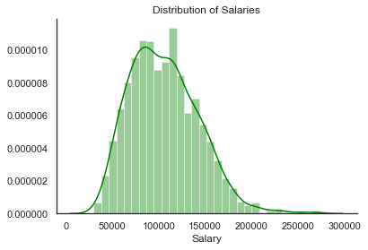
Feature Selection
Target Feature: Salary

Slide 6
Feature Selection
Target Feature: Salary
Key Takeaway:
There is money in Data

Slide 7
Feature Selection
Find features that help the model using:
Simple Linear Regression
DATA
Holdout
Training
Holdout
Validation
Testing

Slide 8
Feature Selection
R - Squared
0
Starting Point:
Language Categories
Programming Language
Python
R
SQL
Java

Slide 9
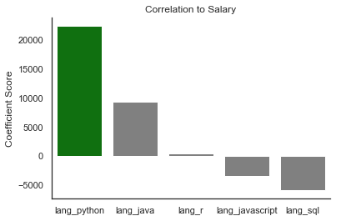
Feature Selection
R - Squared
0.079
Starting Point:
Language Categories: + 0.079

Slide 10
Feature Selection
R - Squared
0.146
Try adding Skills:
Skillset
Data Mining
Statistics
Communication
Predictive Modeling
Presentation
Machine Learning (Tflow, Keras, etc.)
AWS
Big Data (Hadoop, Spark, etc.)
Data Visualization (Tableau, etc.)

Slide 11
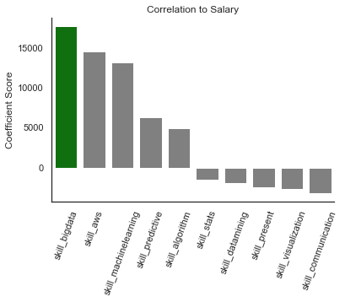
Feature Selection
R - Squared
0.146

Slide 12
Feature Selection
R - Squared
0.154
Try adding Degrees:
Degree
BS
MS
PHD

Slide 13
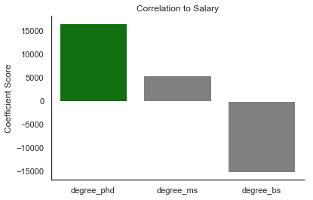
Feature Selection
R - Squared
0.154
Try adding Degrees:

Slide 14
Feature Selection
R - Squared
0.147
Try adding Experience:
Experience
High (4+ years)
Low (0 - 3 years)

Slide 15
Feature Selection
R - Squared
0.147
Try adding Experience:
Experience
High (4+ years)
Low (0 - 3 years)

Slide 16
Feature Selection
R - Squared
0.282
Try adding Title:
Title
Intern
Junior
Senior
Manager
Director

Slide 17
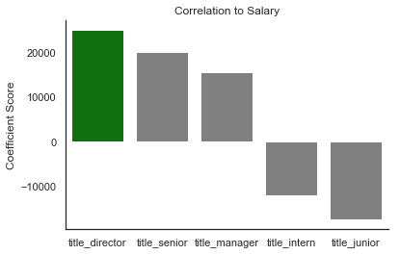
Feature Selection
R - Squared
0.282
Try adding Title:

Slide 18
Feature Selection
R - Squared
0.277
Try adding Company:
Company Specific
Vacation
401k
Health Benefits
Travel
Free Food
Equity
Pets

Slide 19
Feature Selection
R - Squared
0.277
Try adding Company:
Company Specific
Vacation
401k
Health Benefits
Travel
Free Food
Equity
Pets

Slide 20
Feature Selection
R - Squared
0.282
Final Features
Programming Language
Skills
Degree
Title

Slide 21
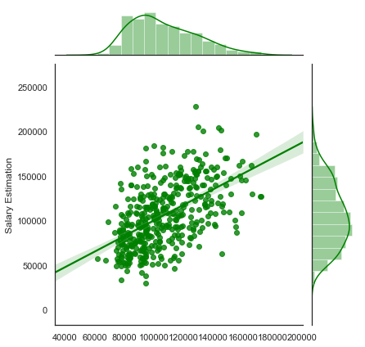
Feature Selection
Actual
Vs
Predicted

Slide 22
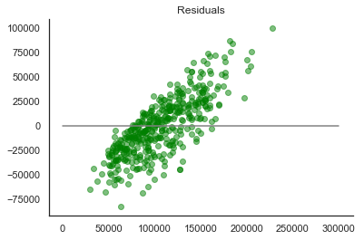
Feature Selection
Linear trend suggests possible relation of features
Transform features based on intuition

Slide 23
Feature Transforms
R - Squared
0.282
Programming Language
Python
R
SQL
Java
Programming Language
Python
R
SQL
Java
Attempt #1:
Attempt #2:
Attempt #3:

Slide 24
Feature Transforms
R - Squared
0.282
Programming Language
Python
R
SQL
Java
Programming Language
Python
R
SQL
Java
Attempt #1:
Attempt #2:
Attempt #3:
Skillset
Data Mining
Statistics
Communication
Predictive Modeling
Presentation
Machine Learning (Tflow, Keras, etc.)
AWS
Big Data (Hadoop, Spark, etc.)
Data Visualization (Tableau, etc.)
Skillset
Data Mining
Statistics
Communication
Predictive Modeling
Presentation
Machine Learning (Tflow, Keras, etc.)
AWS
Big Data (Hadoop, Spark, etc.)
Data Visualization (Tableau, etc.)

Slide 25
Feature Transforms
R - Squared
0.282
Programming Language
Python
R
SQL
Java
Programming Language
Python
R
SQL
Java
Attempt #1:
Attempt #2:
Attempt #3:
Skillset
Data Mining
Statistics
Communication
Predictive Modeling
Presentation
Machine Learning (Tflow, Keras, etc.)
AWS
Big Data (Hadoop, Spark, etc.)
Data Visualization (Tableau, etc.)
Skillset
Data Mining
Statistics
Communication
Predictive Modeling
Presentation
Machine Learning (Tflow, Keras, etc.)
AWS
Big Data (Hadoop, Spark, etc.)
Data Visualization (Tableau, etc.)
Skillset
Data Mining
Statistics
Communication
Predictive Modeling
Presentation
Machine Learning (Tflow, Keras, etc.)
AWS
Big Data (Hadoop, Spark, etc.)
Data Visualization (Tableau, etc.)
Programming Language
Python
R
SQL
Java

Slide 26
Feature Transforms
R - Squared
0.282
Programming Language
Python
R
SQL
Java
Programming Language
Python
R
SQL
Java
Attempt #1:
Attempt #2:
Attempt #3:
Skillset
Data Mining
Statistics
Communication
Predictive Modeling
Presentation
Machine Learning (Tflow, Keras, etc.)
AWS
Big Data (Hadoop, Spark, etc.)
Data Visualization (Tableau, etc.)
Skillset
Data Mining
Statistics
Communication
Predictive Modeling
Presentation
Machine Learning (Tflow, Keras, etc.)
AWS
Big Data (Hadoop, Spark, etc.)
Data Visualization (Tableau, etc.)
Skillset
Data Mining
Statistics
Communication
Predictive Modeling
Presentation
Machine Learning (Tflow, Keras, etc.)
AWS
Big Data (Hadoop, Spark, etc.)
Data Visualization (Tableau, etc.)
Programming Language
Python
R
SQL
Java

Slide 27
Regularization
Current model contains many different features.
Utilize Lasso CV Regression to attempt to generalize the model

Slide 28
Regularization
Current model contains many different features.
Utilize Lasso CV Regression to attempt to generalize the model
Root Mean Squared Error:
+3,500
23 Feature Simple Linear Regression
21 Feature LASSO CV Regression

Slide 29
Regularization
Current model contains many different features.
Utilize Lasso CV Regression to attempt to generalize the model
Root Mean Squared Error:
+3,500
23 Feature Simple Linear Regression
21 Feature LASSO CV Regression

Slide 30
Final Model
R - Squared
Holdout Set
0.314
Simple Linear Regression
Root Mean Squared Error: 30,156
Fully categorical datasets are extremely hard to deal with unless there is a large amount of data

Slide 31
Future Work
R - Squared
0.314
No amount of transformation will help the model unless the features have enough data to see trends
Gather MORE DATA
More data will allow the feature buckets to be tweaked to be more focused and reduce the models collinearity

